Slide 1
Task 2 : VIBHUTI PATIL
Report on http://zero.webappsecurity.com/ ,
Report based on : 25-08-2021
Target :
Domain: http://zero.webappsecurity.com/
Target IP : 54.82.22.214
Searched Version : 7.0.70
Latest Version : 10.0.5
Classifications : PCI 3.1 - 6.2
PCI 3.2 - 6.2
OWASP 2013 - A9
CAPEC - 310
Vulnerabilities : Category : CRITICAL .
Certainty : HIGH .
4 critical vulnerabilities with 44 other vulnerabilities.
Details : The most critical vulnerability found is resource.js ,that is OUT OF DATE (Tomcat).

Slide 2
Impact : Impact of the critical vulnerability :
OUT OF DATE (TOMCAT) :
Out of date as the name suggests its an out of date version website which means its an old version of the software , which will attract a lot of problems, such as : Easiest gateway for cybercriminals. Can cause loss of data by software failures Bugs in the operating systems. Drop in productivity caused by poor software performance . Incompatibility . Can cause Malware attacks .
Remedy : Remedy for the critical vulnerability :
OUT OF DATE (TOMCAT) :
The simple remedy for Out of date vulnerabilities are UPGRADING the software to the latest versions . Upgrading the operating systems . There are many links for upgrading out of date vulnerabilities with tomcat vulnerabilities too. Some of these links are below : https://tomcat.apache.org/security-8.html#Apache_Tomcat_8.x_vulnerabilities https://tomcat.apache.org/security-8.html#Fixed_in_Apache_Tomcat_8.5.66 https://tomcat.apache.org/security-8.html#Fixed_in_Apache_Tomcat_8.5.68

Slide 3
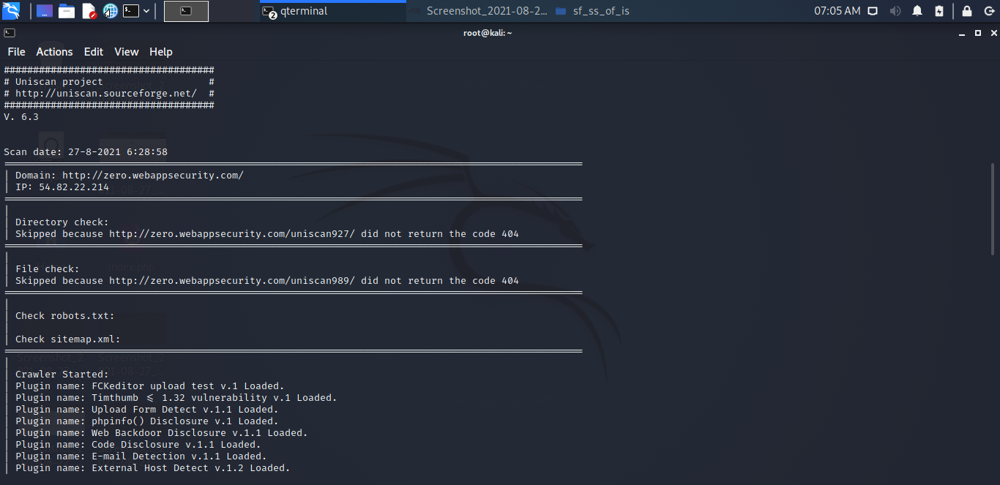
Some other vulnerabilities : Apache tomcat Deserialization of untrusted Data vulnerabilities . Out of date (jQuery) . Apache server-status Detected . Apache Tomcat Exposure of sensitive Information to an Unauthorized Actor. Apache Tomcat Insufficient Information Vulnerability. Password Transmitted over HTTP . Cross site requests .

